Slide 1
CUBITAL FOSSA
By
Dr.Leena. N
Associate Professor
Department of Anatomy

Slide 2
CUBITAL FOSSA
A triangular shaped depression in front of elbow. Bounded
Laterally –by Brachioradialis
Medially –by Pronator teres
Superiorly –by an imaginary line connecting the epicondyles of Humerus

Slide 3
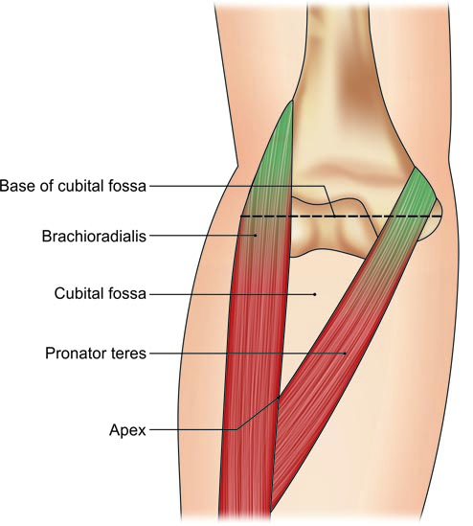
Boundaries of the right cubital fossa

Slide 4
Roof
Skin
Superficial fascia with Median cubital vein, Medial &Lateral cutaneous nerves of forearm.
Deep fascia with Bicipetal aponeurosis

Slide 5
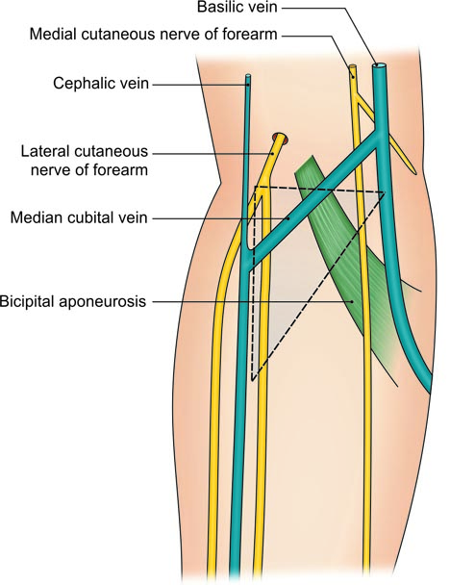
Structures in the roof of the right cubital fossa

Slide 6
Contents
Median nerve
Brachial artery which divides into Radial and Ulnar arteries
Tendon of Biceps brachi
Radial Nerve

Slide 7
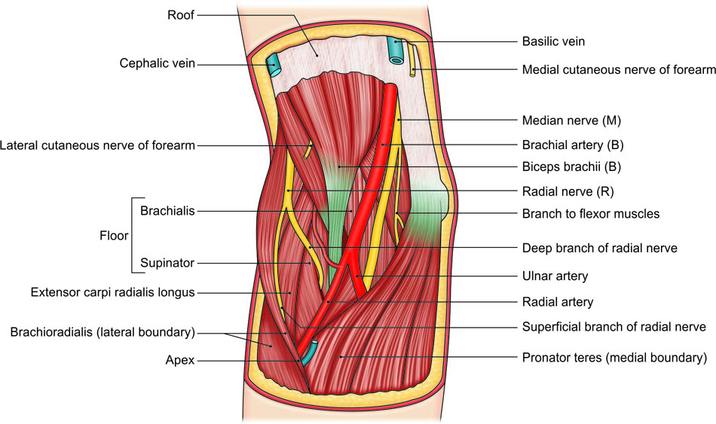
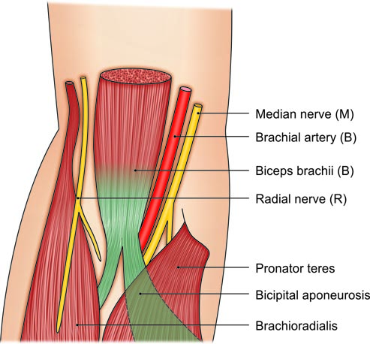
Muscles forming floor of right cubital fossa with its contents; contents shown as mnemonic—MBBR

Slide 8
Floor
Brachialis
Supinator

Slide 9
Contents of the right cubital fossa; mnemonic—MBBR

Slide 10
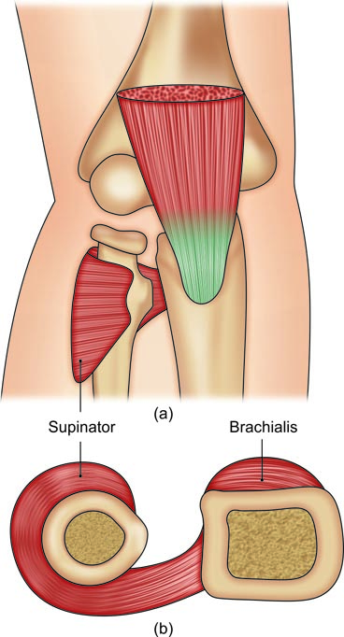
The floor of the cubital fossa is formed by the brachialis and supinator muscles: (a) Surface view, and (b) cross-sectional view

Slide 11
Applied aspects
Median cubital vein is the vein of choice for intravenous injections
BP is universally recorded by auscultating Brachial artery in the Cubital fossa

